Slide 1
Chapter 5
Integration
Copyright © 2010 Pearson Education, Inc. Publishing as Pearson Addison-Wesley

Slide 2
5.1
Area and Estimating with Finite Sums
Copyright © 2010 Pearson Education, Inc. Publishing as Pearson Addison-Wesley

Slide 3
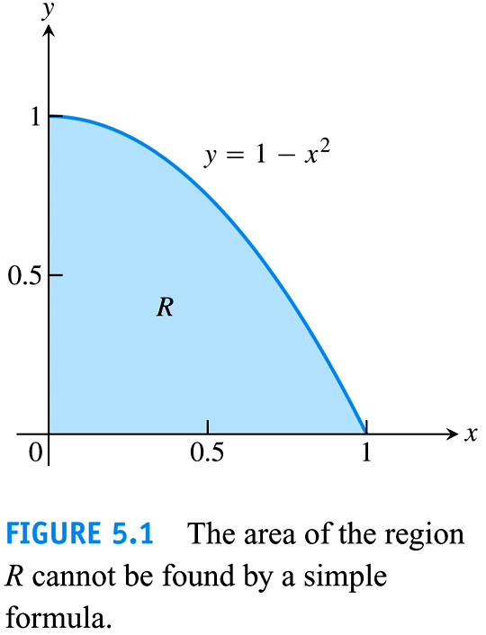

Slide 4
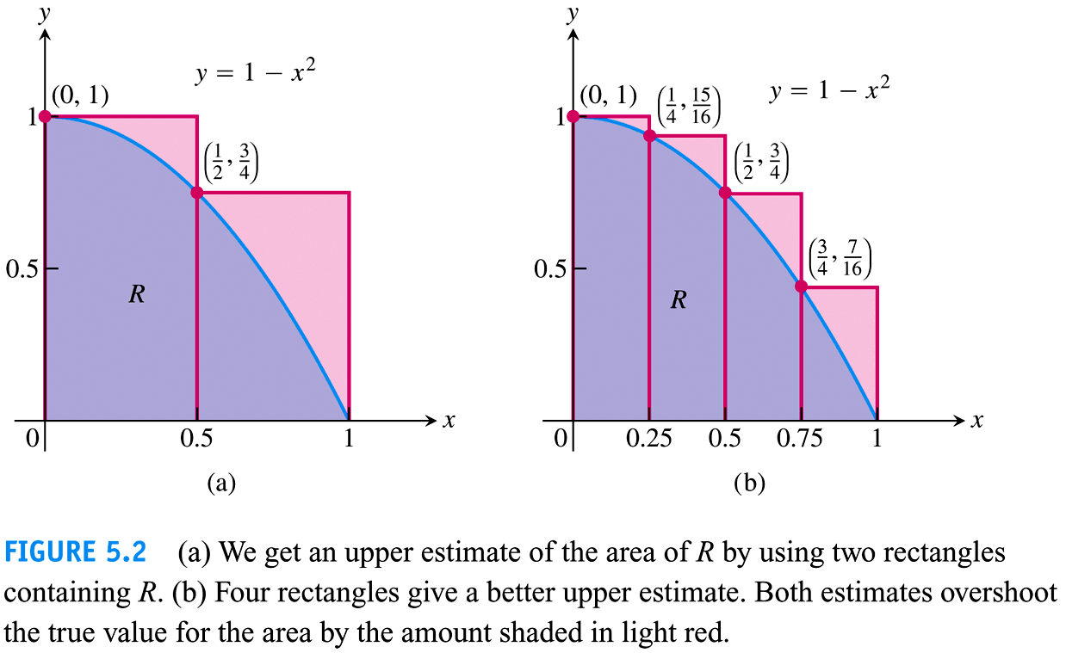

Slide 5
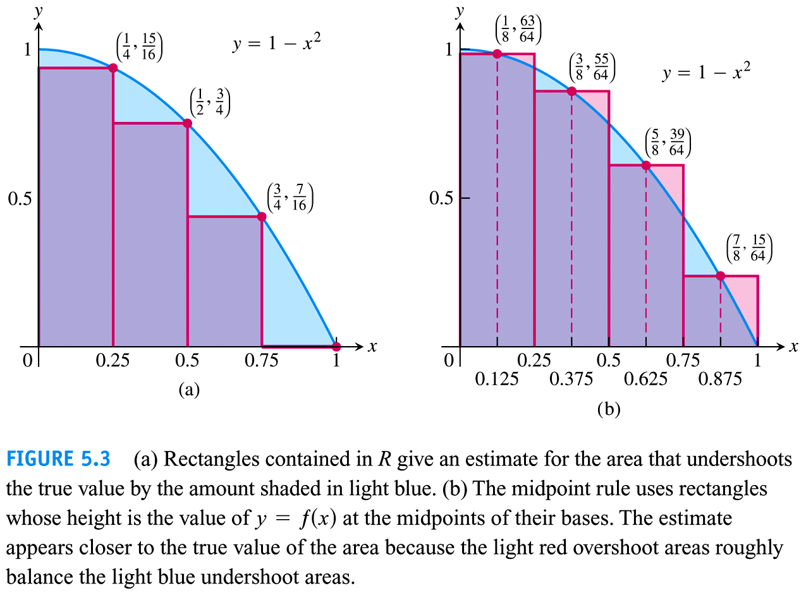

Slide 6
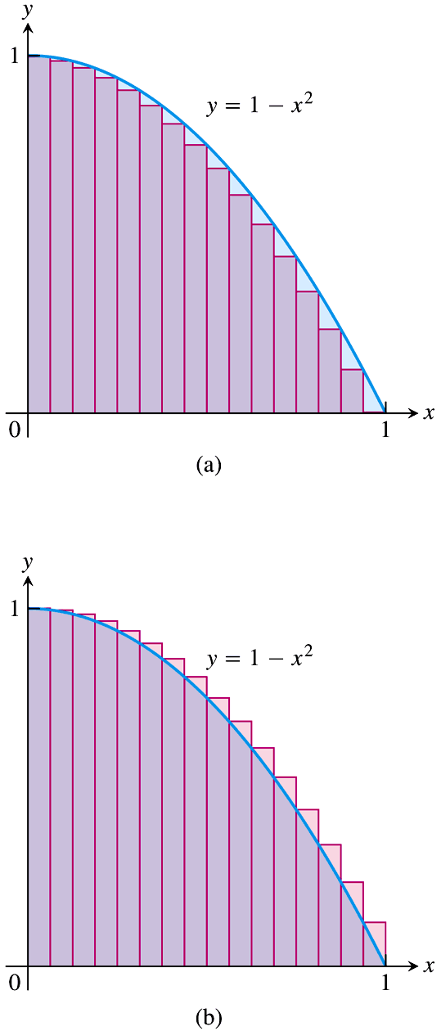
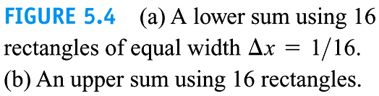

Slide 7
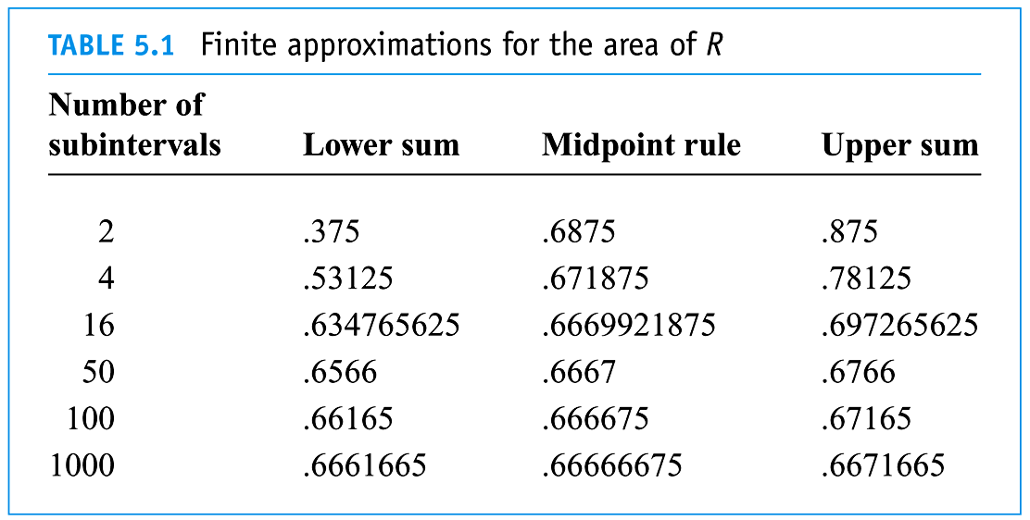

Slide 8
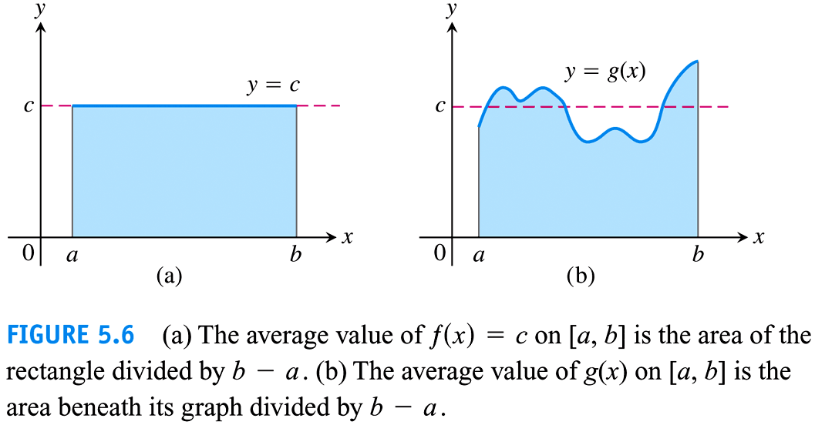

Slide 9
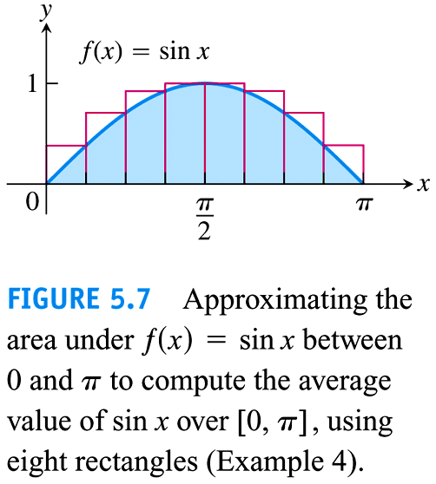

Slide 10
5.2
Sigma Notation and Limits of Finite Sums
Copyright © 2010 Pearson Education, Inc. Publishing as Pearson Addison-Wesley

Slide 11
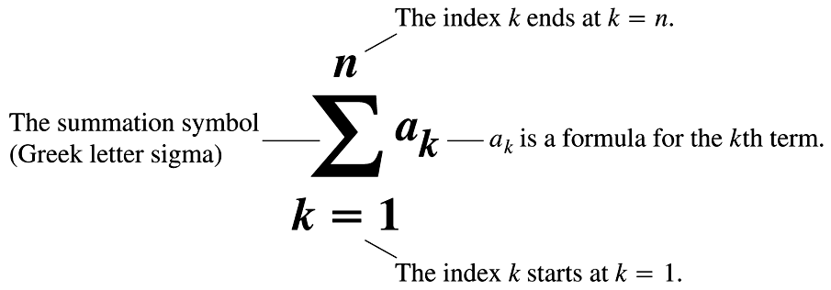

Slide 12
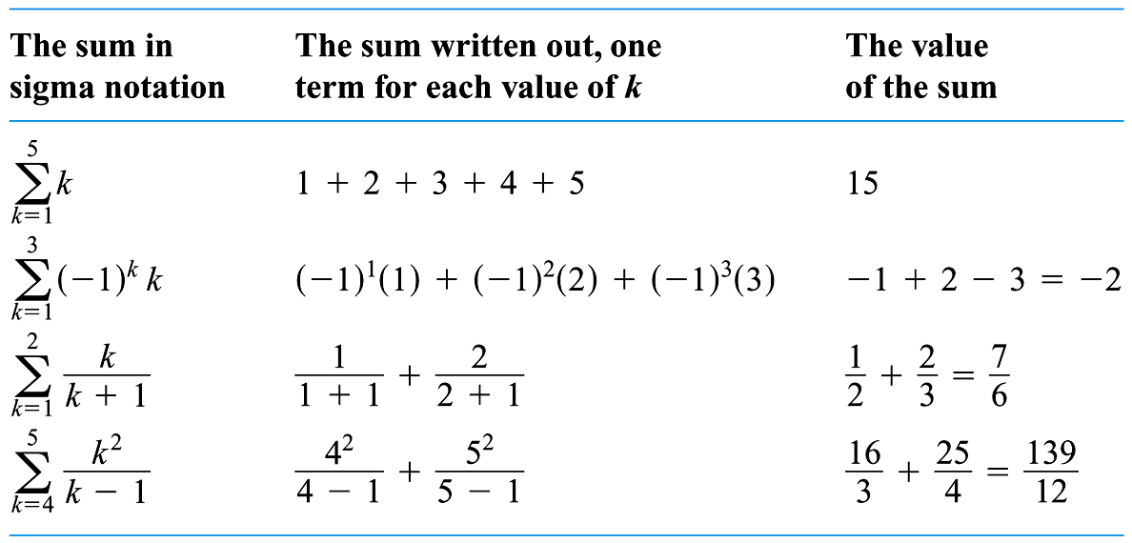

Slide 13
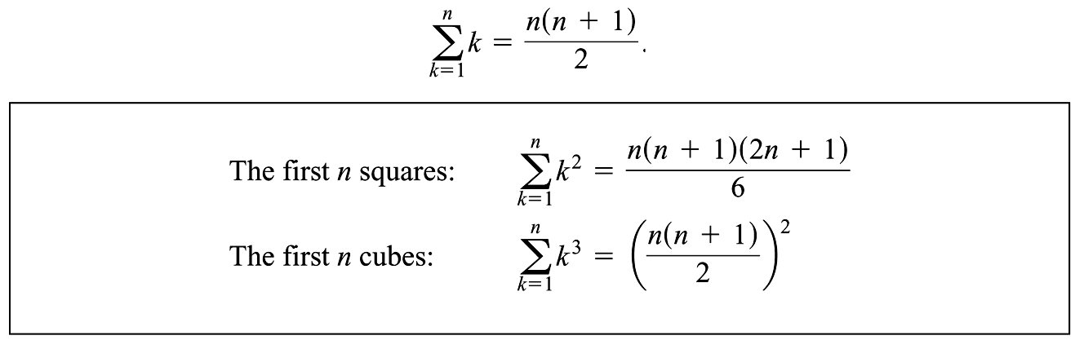

Slide 14
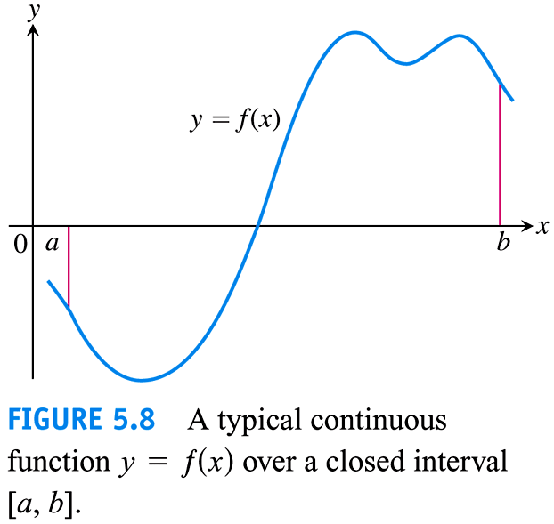

Slide 15
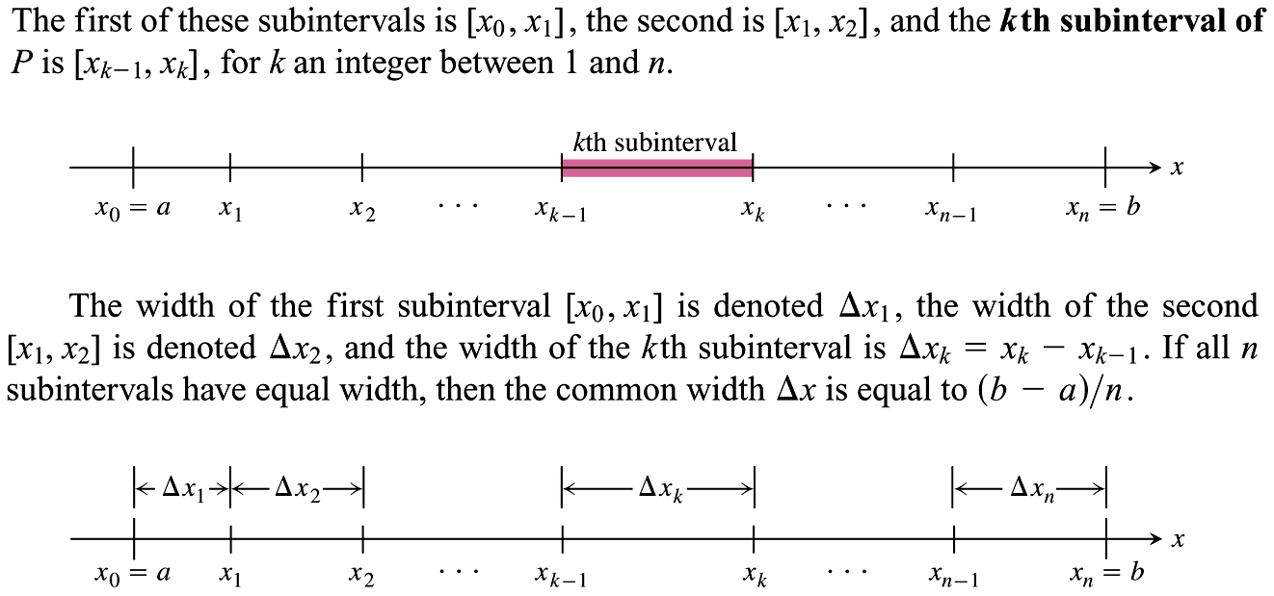

Slide 16
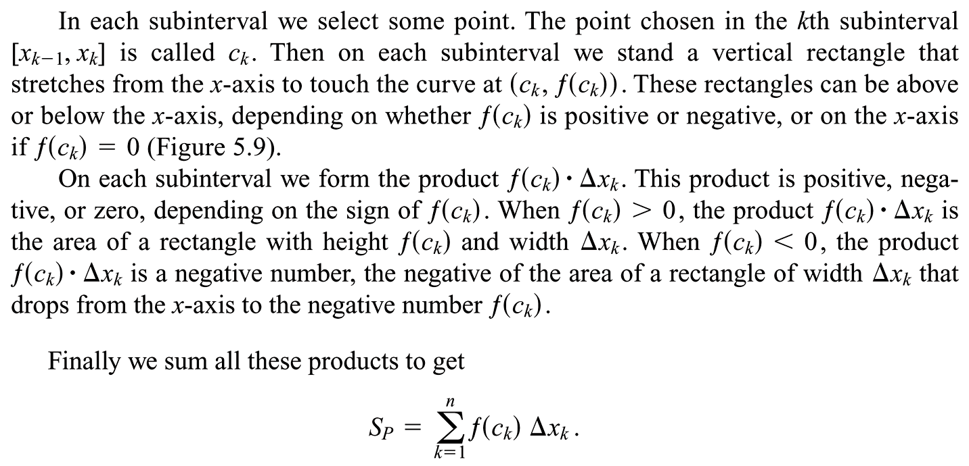

Slide 17
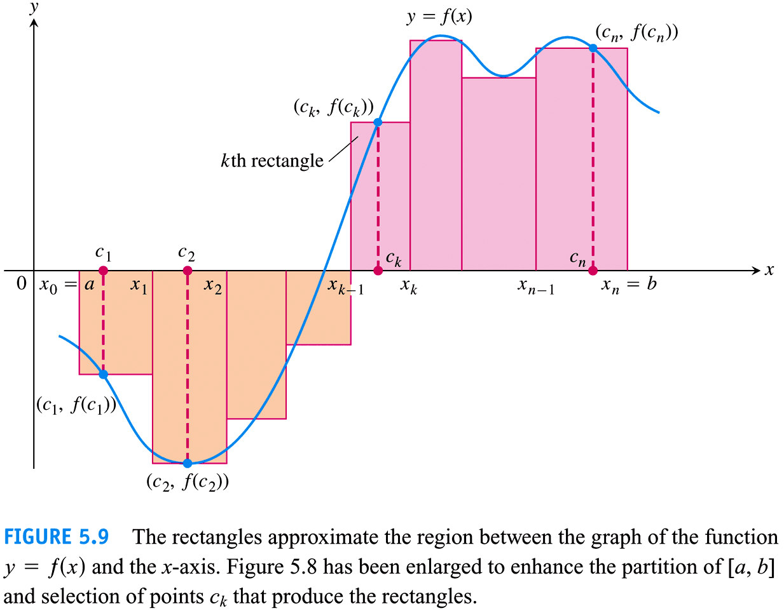

Slide 18
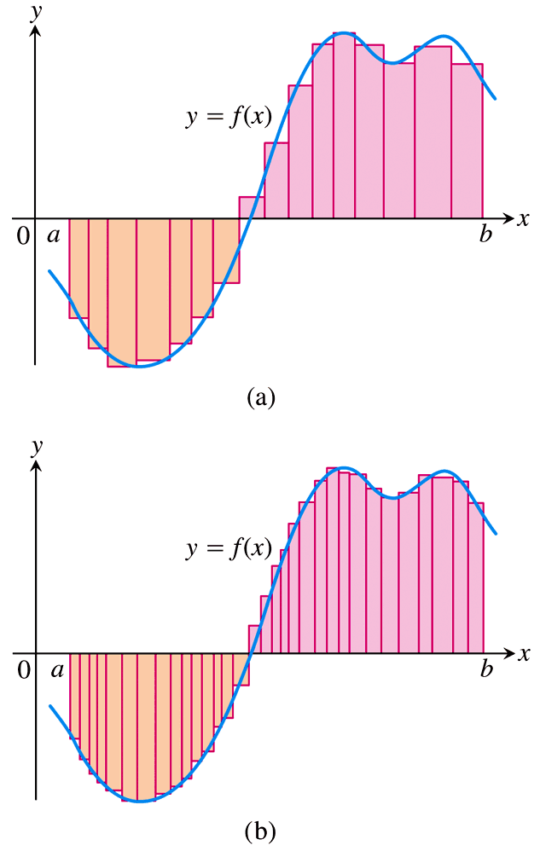
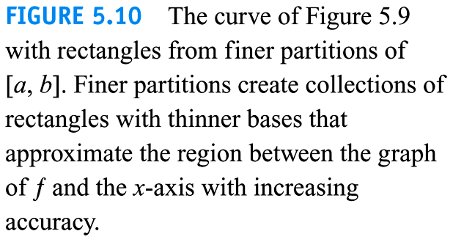

Slide 19
5.3
The Definite Integral
Copyright © 2010 Pearson Education, Inc. Publishing as Pearson Addison-Wesley

Slide 20
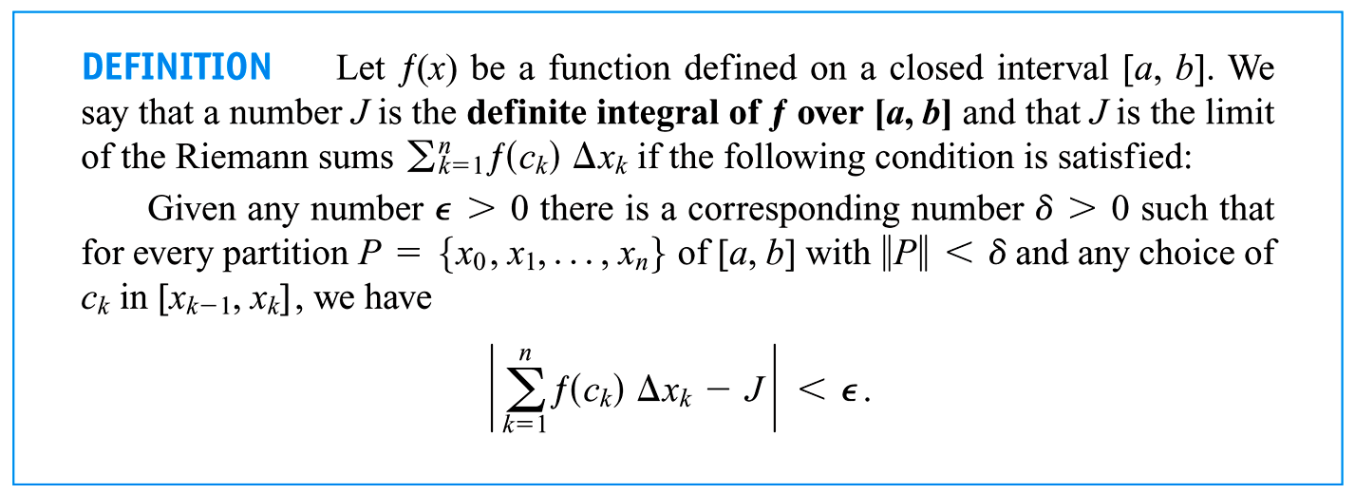
5.3
The Definite Integral
Copyright © 2010 Pearson Education, Inc. Publishing as Pearson Addison-Wesley

Slide 21
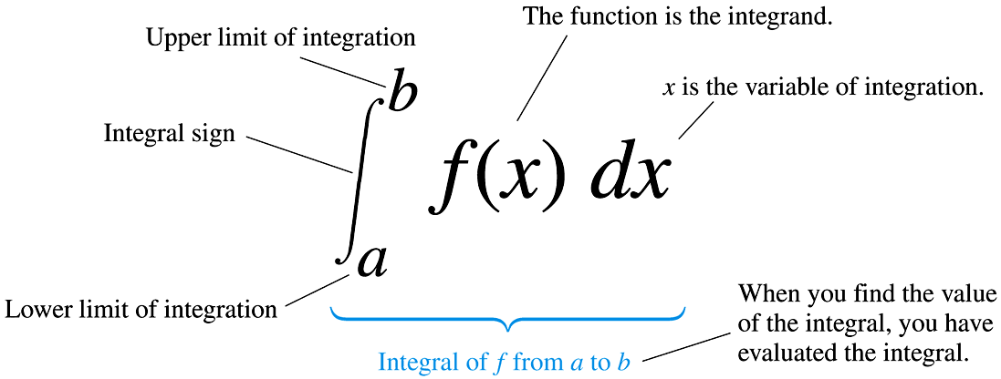

Slide 22
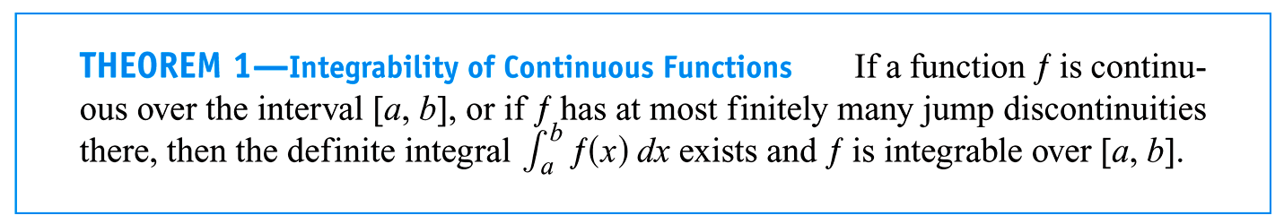

Slide 23
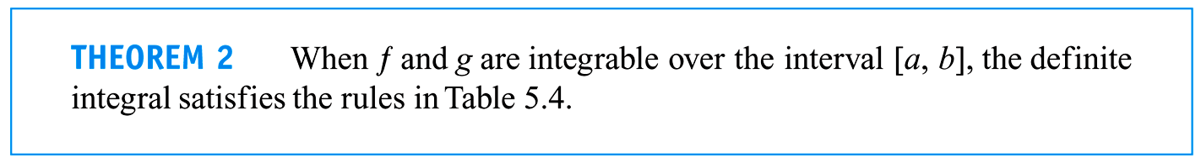

Slide 24
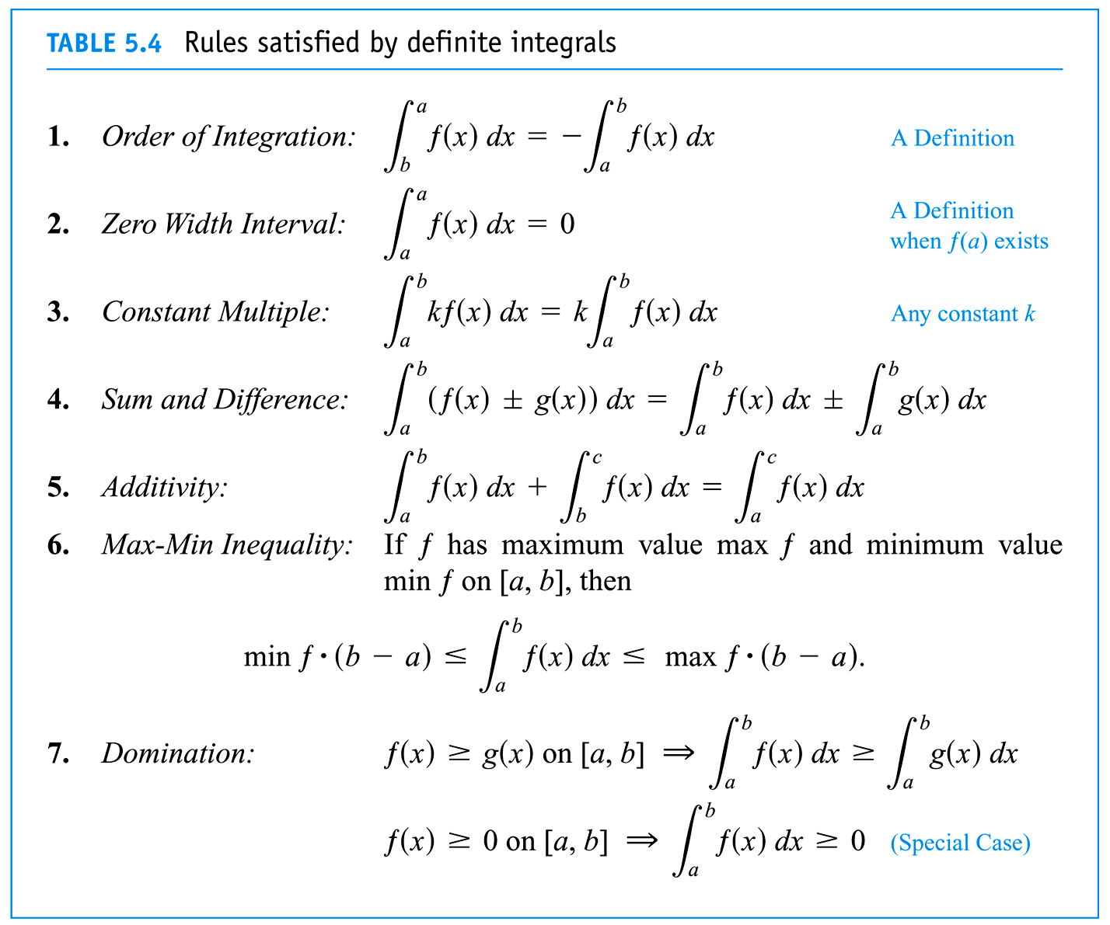

Slide 25
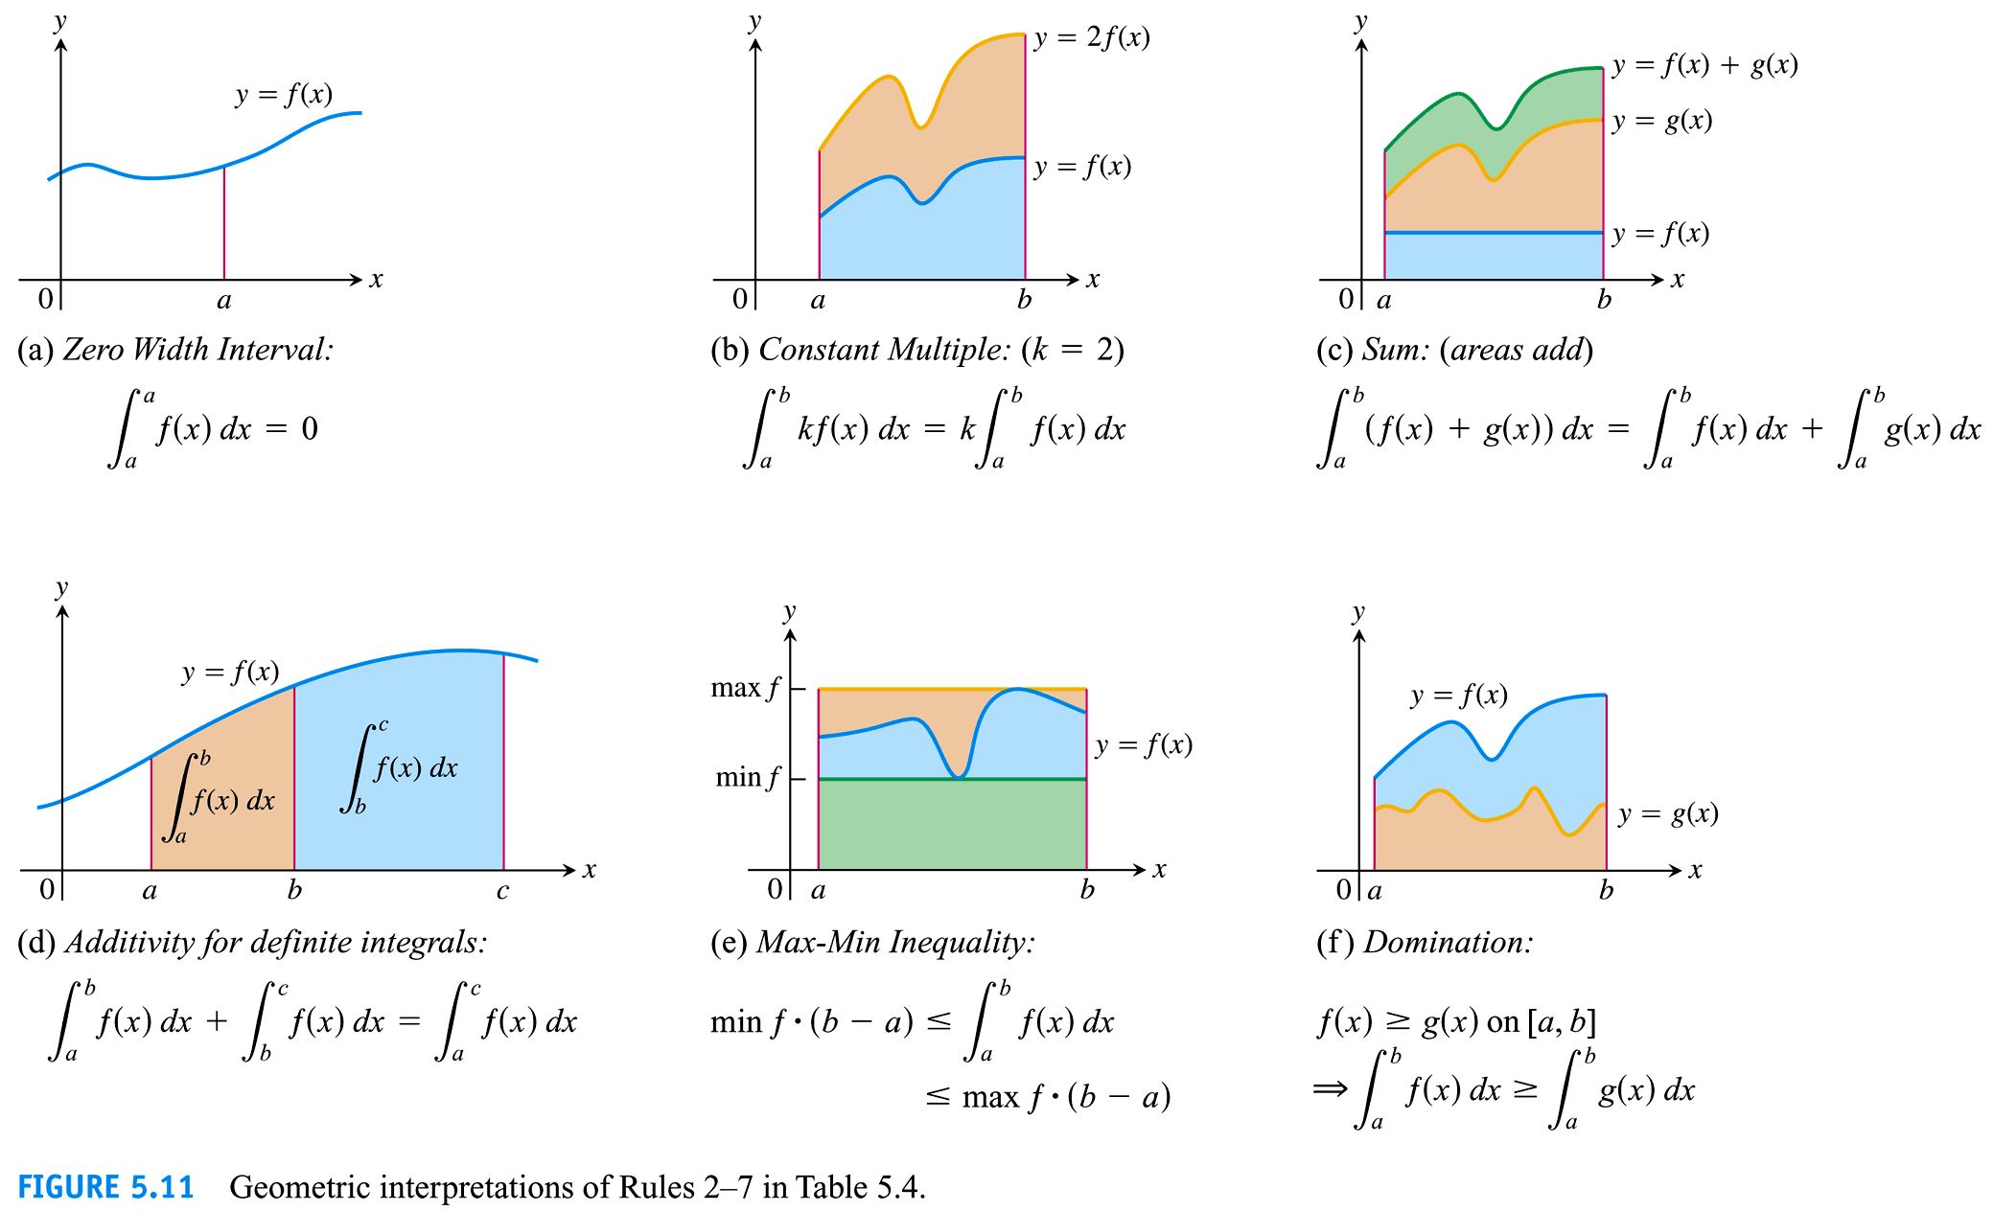

Slide 26
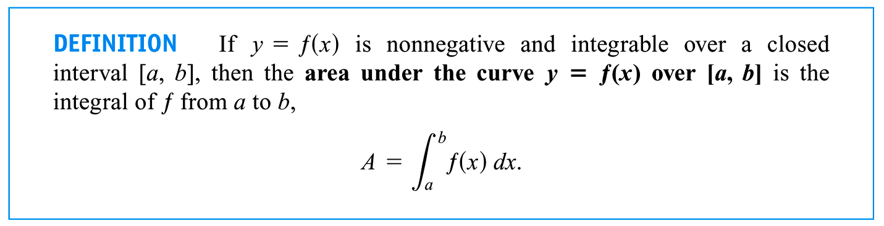

Slide 27
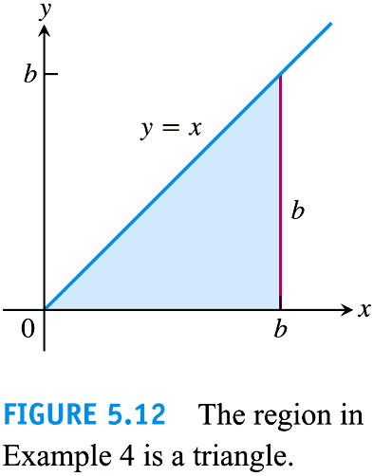

Slide 28
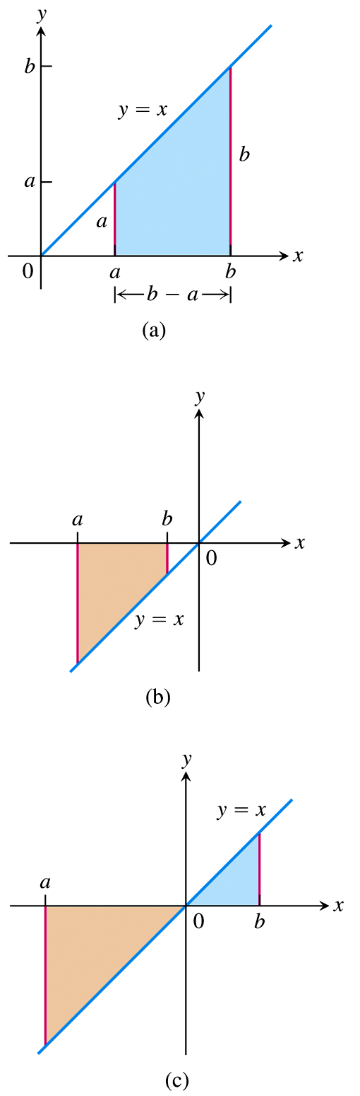
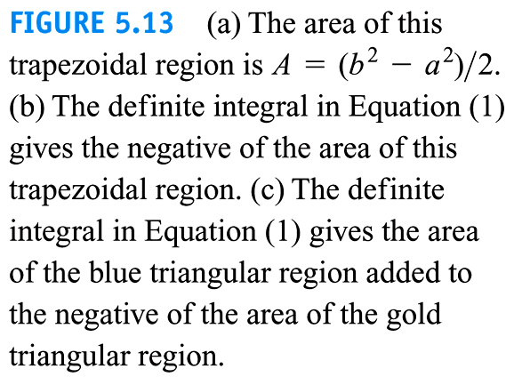

Slide 29



Slide 30
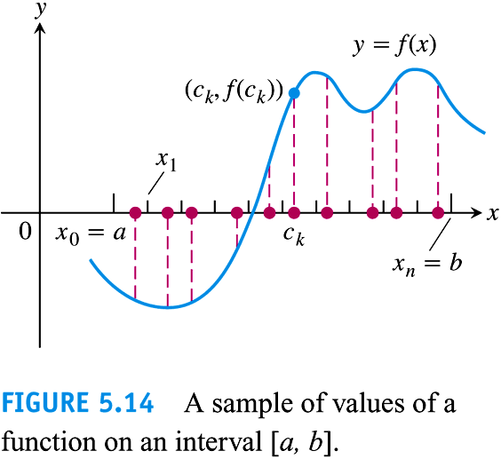

Slide 31
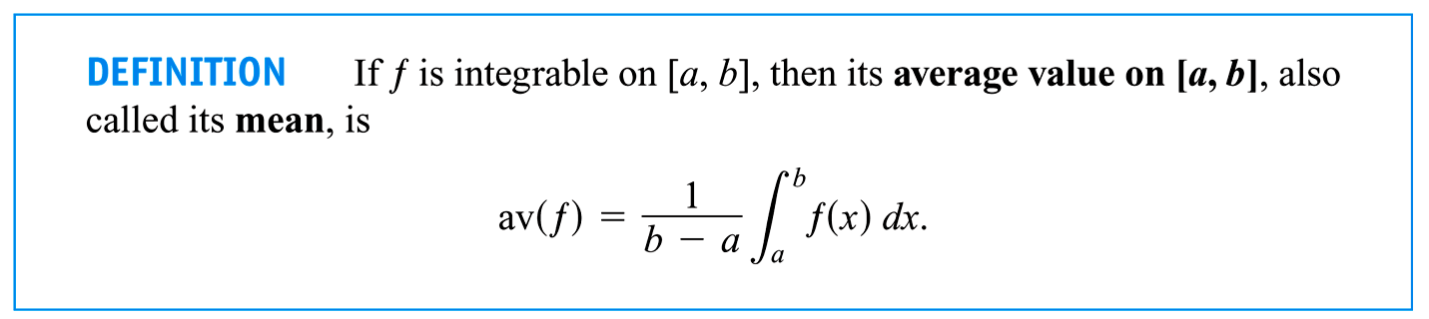

Slide 32
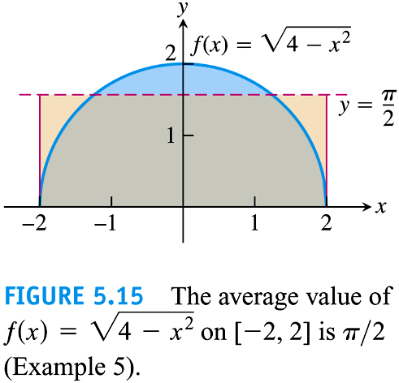

Slide 33
5.4
The Fundamental Theorem of Calculus
Copyright © 2010 Pearson Education, Inc. Publishing as Pearson Addison-Wesley

Slide 34
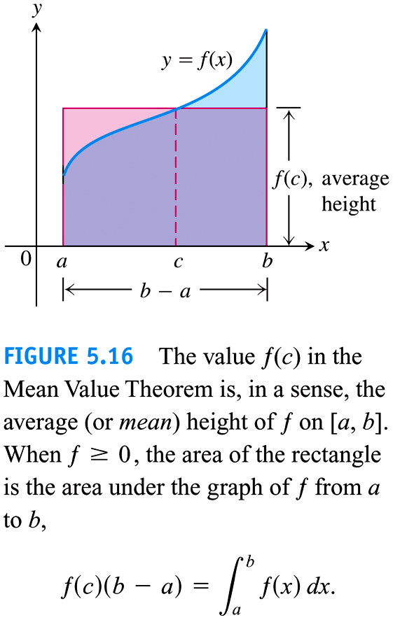

Slide 35
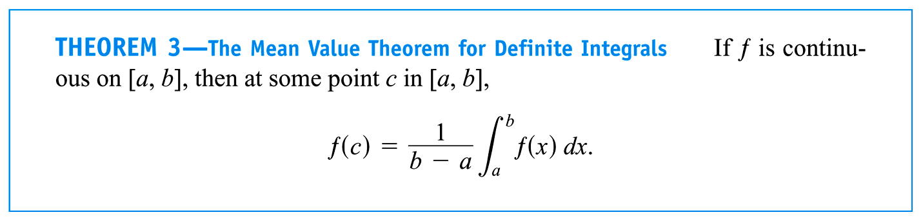

Slide 36
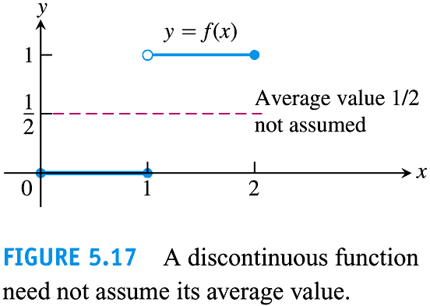

Slide 37
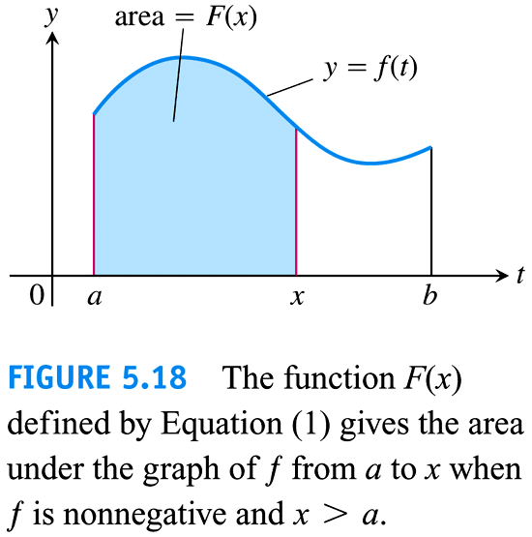

Slide 38
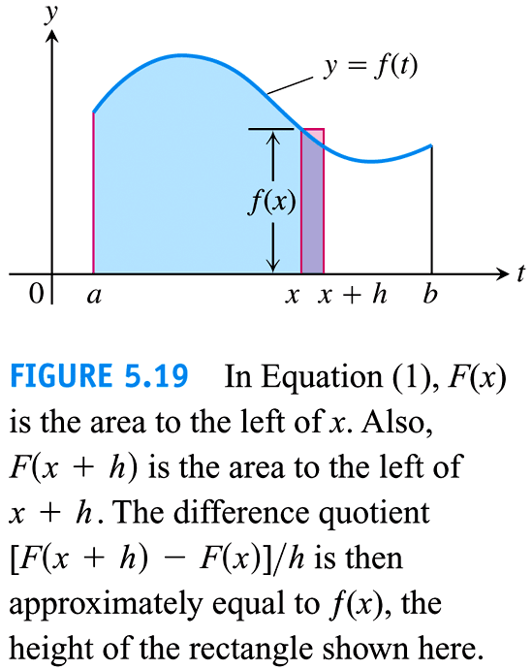

Slide 39
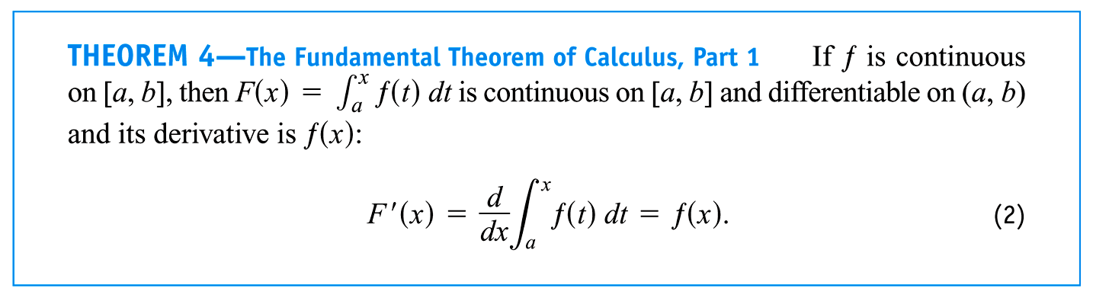

Slide 40
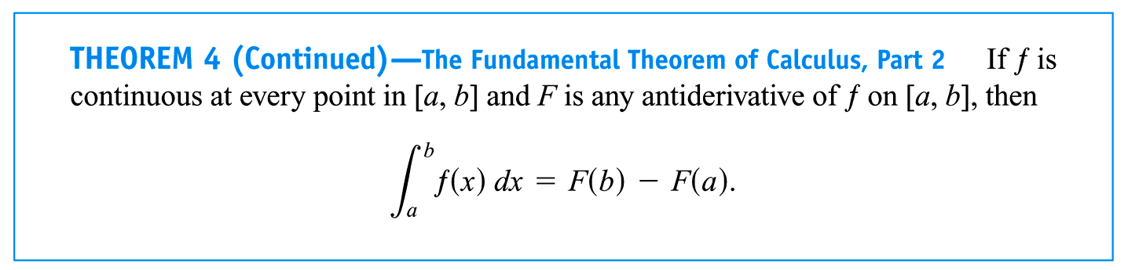

Slide 41
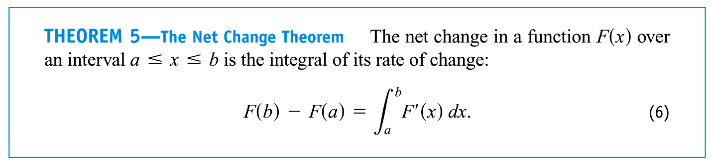

Slide 42
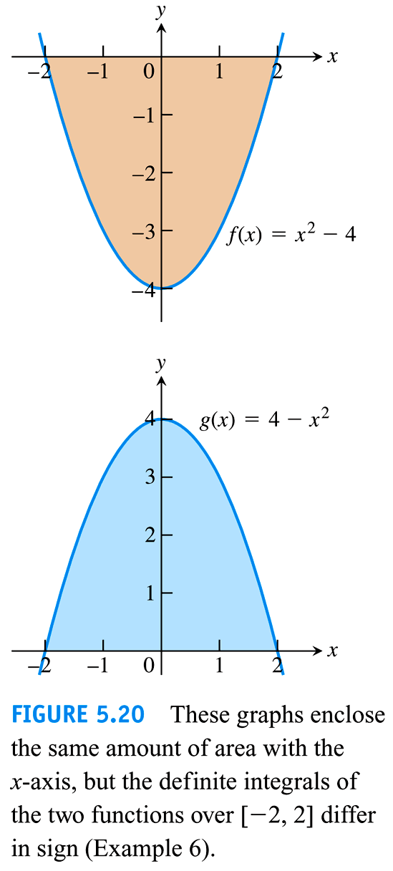

Slide 43
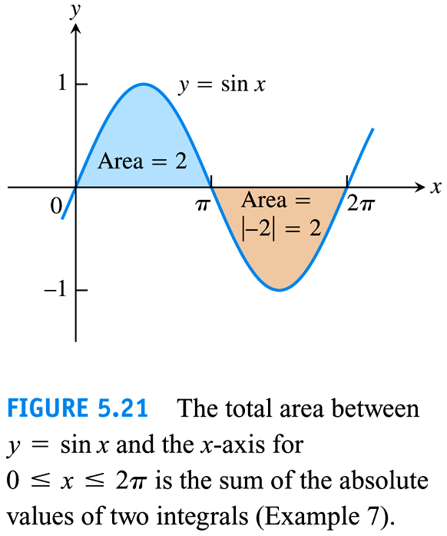

Slide 44
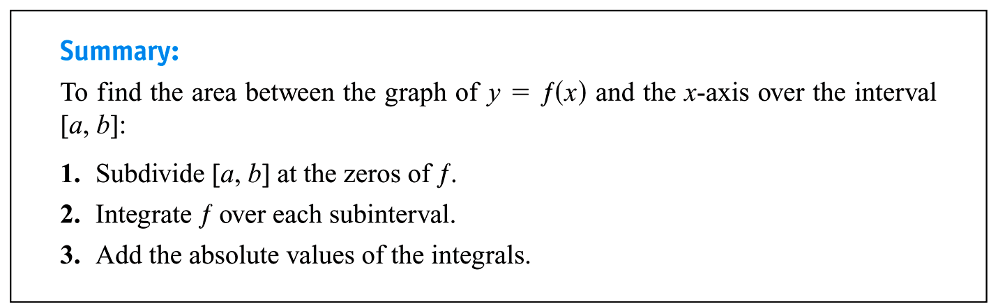

Slide 45
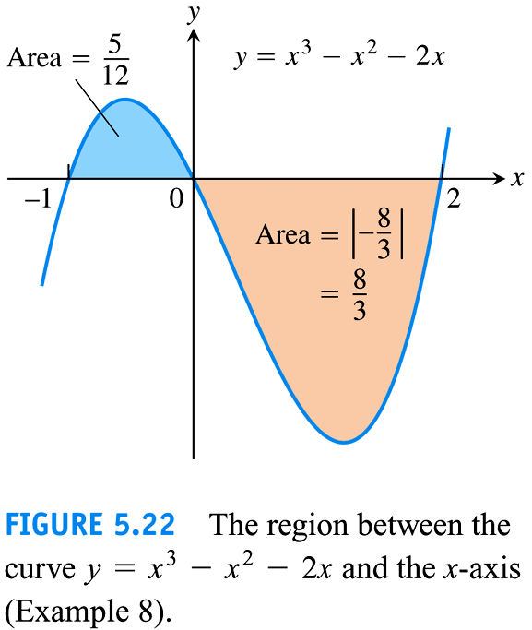

Slide 46
5.5
Indefinite Integrals and the Substitution Method
Copyright © 2010 Pearson Education, Inc. Publishing as Pearson Addison-Wesley

Slide 47
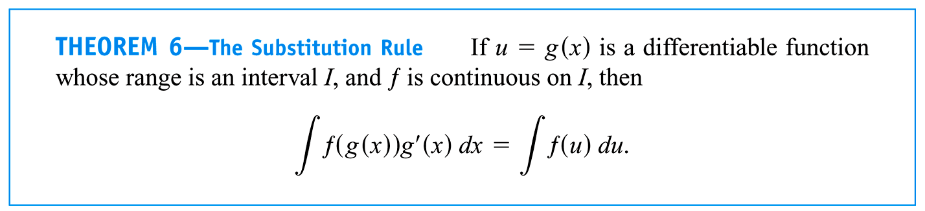

Slide 48
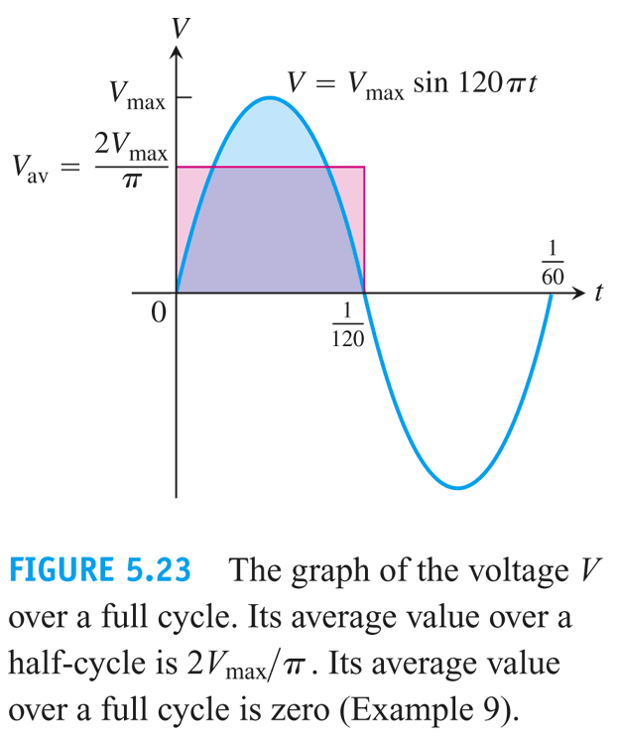

Slide 49
5.6
Substitution and Area Between Curves
Copyright © 2010 Pearson Education, Inc. Publishing as Pearson Addison-Wesley

Slide 50
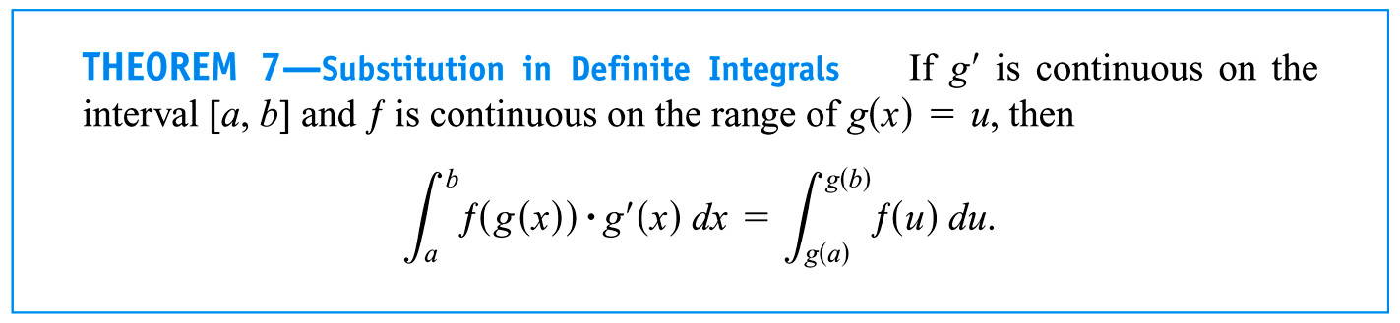

Slide 51
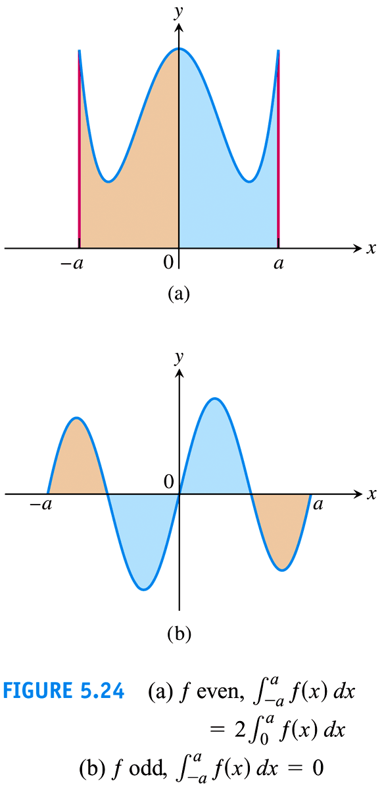

Slide 52
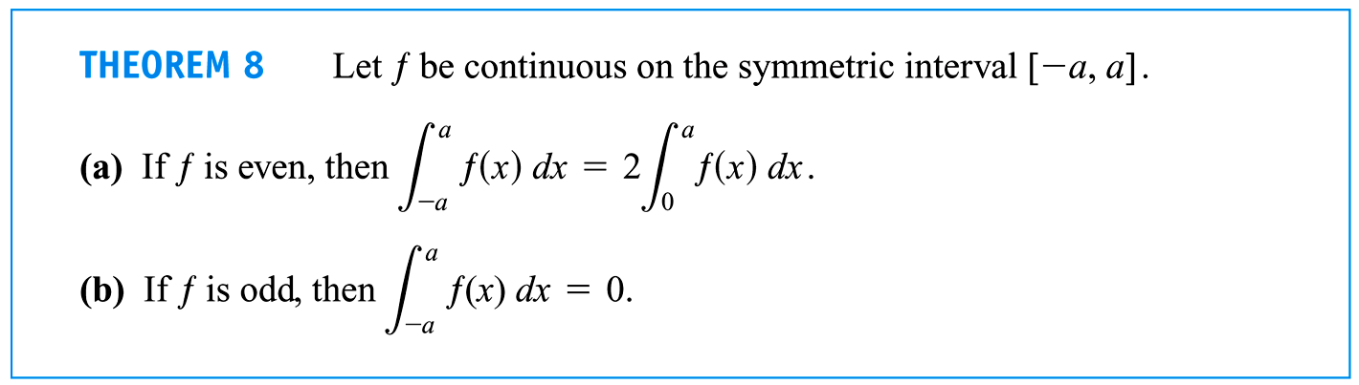

Slide 53
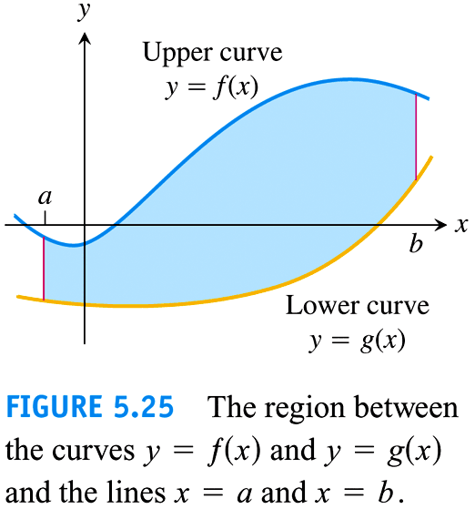

Slide 54
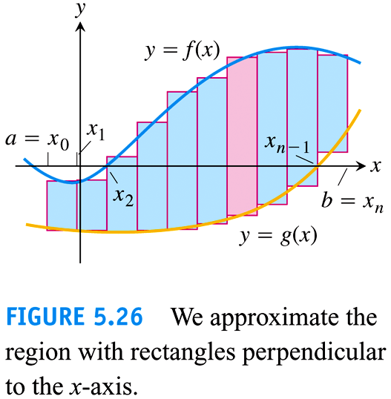

Slide 55
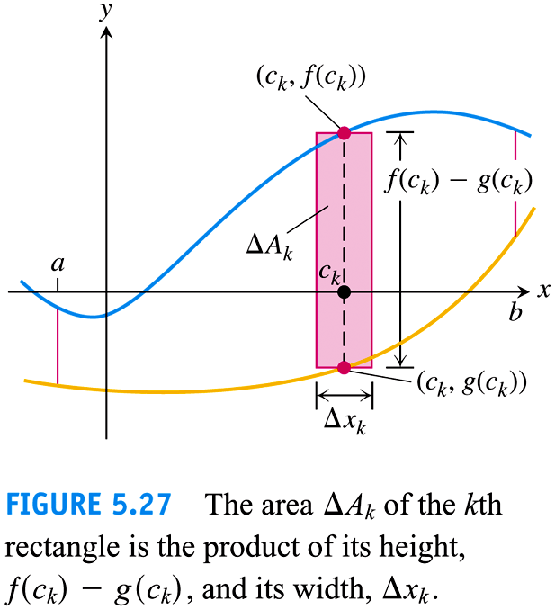

Slide 56


Slide 57


Slide 58


Slide 59


Slide 60


Slide 61


